Slide 1
PaNOSC Portal PaNOSC Annual Meeting
6th November, 2019
Jamie Hall (ILL)

Slide 2
Summary
Objectives of WP4
Example use cases
Cloud services
What is the PaNOSC portal?
Deployment
Searching for data
AAI and data access
Architectural ideas / objectives
Current work
Links and documentation

Slide 3
Data Analysis as a Service: Objectives of WP4
Analyse data remotely
Transparently (irrespective of where the data and compute resources are hosted)
Collaborate with your experimental team
Record your analysis process
Long term archive
Publish your analysis results / process / environment
Make these findable (FAIR)
Share resources between compute environments
Scripts, data etc.
Learning resources
Tutorials, videos, screencasts etc. (WP8)
Exploring / finding analysis procedures / examples

Slide 4
Data Analysis as a Service: Example use cases
I want to be able to find data to analyse for an experiment at a given institute
I want to explore/search for public analysis results
I would like to request a compute resource that is capable of analysing the data.
I would like to have software (applications and libraries) available to analyse the data
I want to be able to collaborate with a colleague to analyse data together
https://confluence.panosc.eu/display/wp4/Common+Portal+Use+Cases

Slide 5


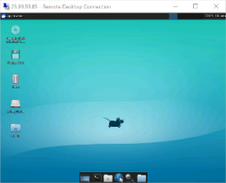
Data Analysis as a Service: Cloud Services
Data

Slide 6
Data Analysis as a Service: Jupyter Notebooks
On-demand compute resources
Memory, CPU, GPU etc.
Notebook templates for common analysis procedures
Instrument, type of data, facility etc.
Building on the ecosystem
Widgets, extensions, visualisation etc.
Transparently switch between remote desktops and notebooks
Share resources between notebooks and virtual machines (files, scripts etc.)
Snapshots of notebook
Dependencies etc.
Publishing notebooks
DOIs

Slide 7
Data Analysis as a Service: Remote Desktop
Building on experience from VISA & CalipsoPlus
On-demand compute resources
Memory, CPU, GPU etc.
Access to data analysis software
Ideal for legacy software
Shared desktop
Collaborate with your colleagues / experimental team
Environment snapshots
Dependencies, environment, repositories, software etc.
Possibility to analyse data from the same environment in 10 years time
Recording
Screen recording of the analysis process
Annotating the process

Slide 8
What is the PaNOSC portal?
A common interface to access these services
Gives access to Jupyter Notebooks or Remote Desktops
Access to computational resources at each partner site
Access to job submission systems
Use your credentials to log in
AAI handled by services provided in WP6
Search and access private or public data
Searching for data provided by WP3
Accessing data provided by WP6
Store analysis results
Collaborate with colleagues / experimental team

Slide 9
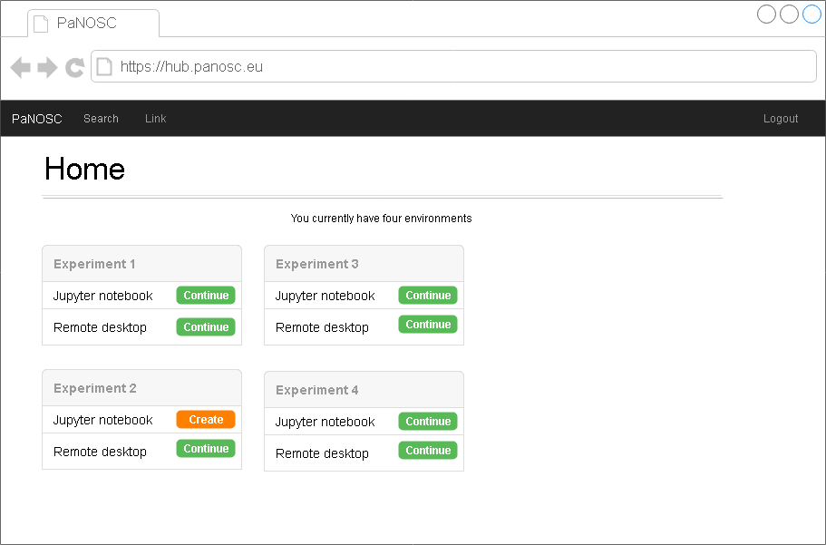
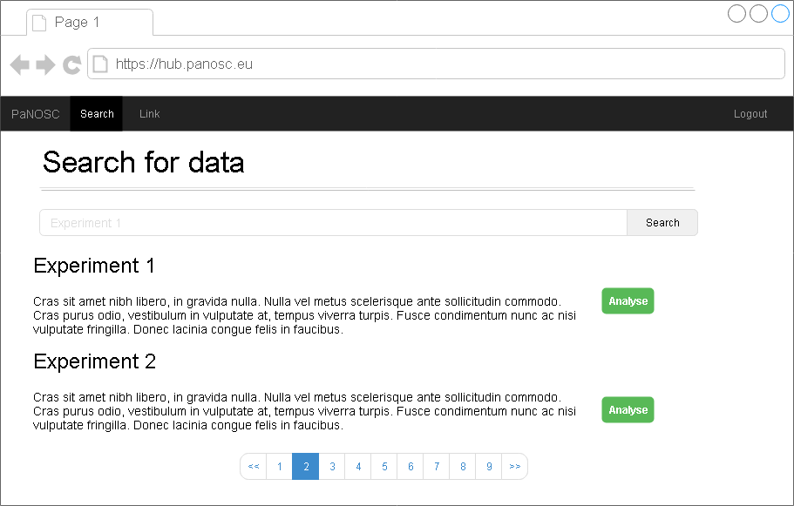
Story Board

Slide 10
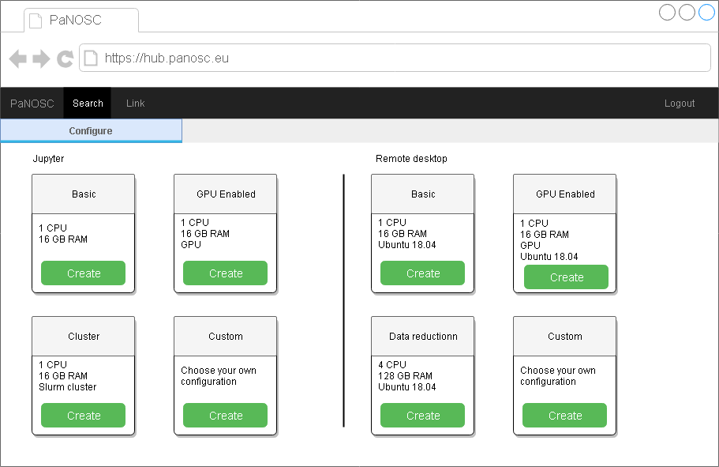
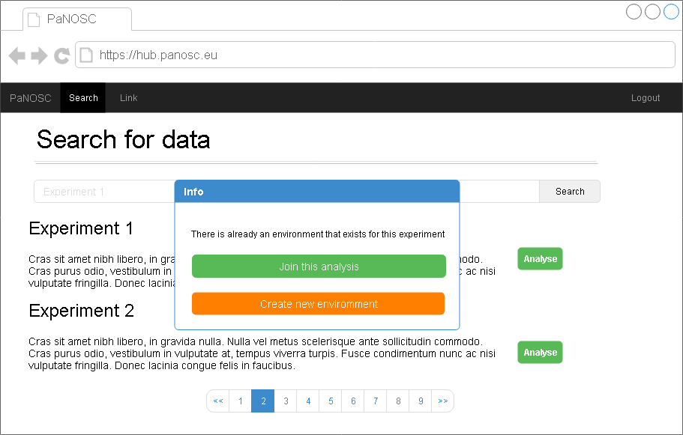
Story Board

Slide 11
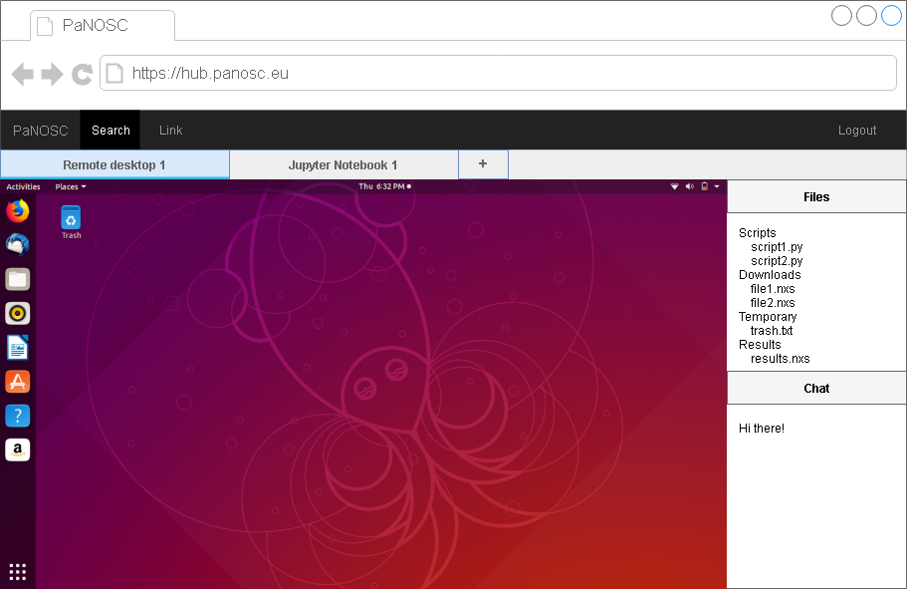
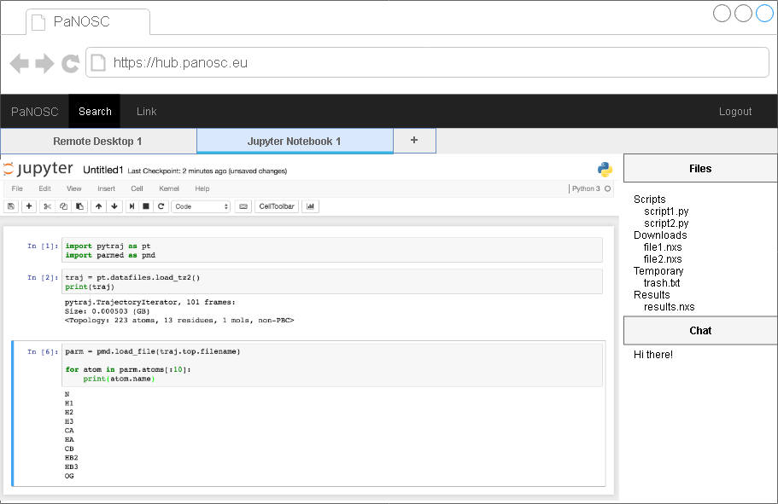
Story Board

Slide 12
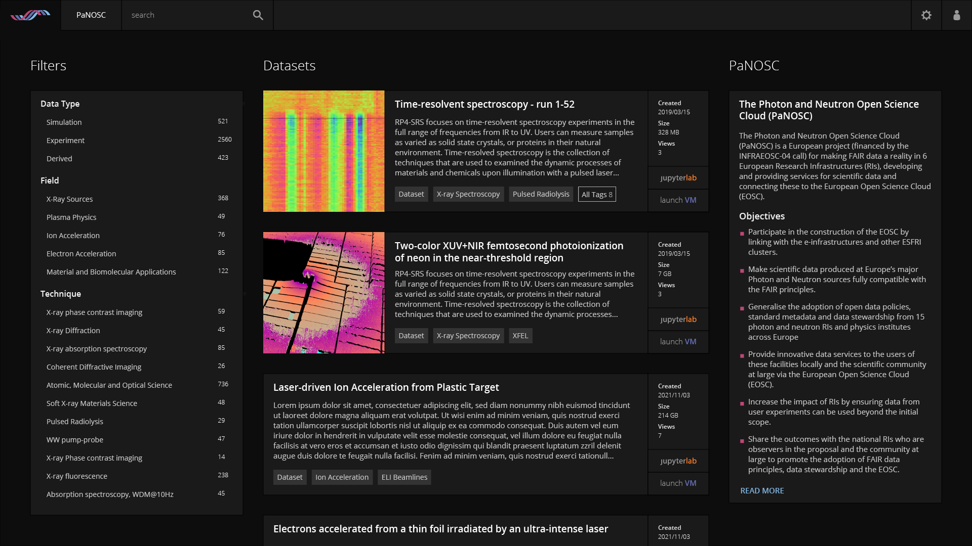
Proposed UI (ELI)

Slide 13
Deployment
Local deployment
Deploy the portal locally at each partner site
Initial objective
Validate with local users
Build on feedback
Federated deployment
A federated deployment of the portal accessed through a single endpoint
Same code base
Integration with EOSC services

Slide 14
Searching for data: WP3
Using the FAIR Data API provided by WP3
Search for data using a defined query language
Filter search results
Entry point to WP4
Searching both public and private data
Create compute resources for a given dataset(s)
Common portal will integrate this API
The search interface will be the demonstrator for WP3
Close collaboration is necessary between both work packages

Slide 15
AAI and Data Access: WP6
Authenticate to the portal
Authentication protocols provided by WP6
Most likely to be OIDC although others will be available to use
New authentication IDP is currently in pilot phase
Access data
Access private & public data
Transfer data between institutes
Access protocol unknown for the moment – still in the exploration stage
EGI has proposed infrastructure resources

Slide 16
Architectural ideas / objectives
Aim to have a flexible/decoupled system
Move away from a monolithic application structure
Easy to have multiple developers developing separate functionalities (shared responsibilities)
Facilitates cross-site development collaboration
Enable site-specific implementations
Less dependence on a single language
Well-defined API for each module/service
Re-use of components
Microservice Architecture seems well adapted to these requirements

Slide 17
Current work
Defined a first iteration
Prototype creation of Remote Desktops and Jupyter Notebooks in common portal
Architecture specification
A work in progress
https://confluence.panosc.eu/display/wp4/Common+Portal+Initial+Design
Development has started
Initial prototype implementation completed for March 2020
Data analysis requirements survey distributed to all partners
Results will be made publically available
Work has started on the UI design (ELI)
https://confluence.panosc.eu/display/wp4/Portal+Design
Milestones have been defined

Slide 18
Links and documentation
Documentation
https://confluence.panosc.eu/display/wp4
Minutes and presentations
https://github.com/panosc-eu/panosc/tree/master/Work%20Packages/WP4%20Data%20analysis%20services
Email
wp4@panosc.eu

Slide 19
Thank you
hall@ill.eu

